Slide 1
Purchasing and inventory control
Chapter no 7

Slide 2
Purchasing and Inventory Control in MM
Material Management is one of the critical and crucial part of every organization involved in manufacturing process.
Bad Management of inventory, purchasing methods has lead to fall of organizations.
Total number of Spares varies from organization to organization.
An Efficient and Effective Material Management System is important in the purchasing and inventory control for Effective Cost Control in maintenance.

Slide 3
Inventory Control
OBJECTIVES
To minimize the capital blocked up in inventory or in other words maintain optimum level of inventory .
To strike a balance between production costs and operating and maintenance costs.
To avoid wastages, losses and optimum utilization.

Slide 4
Inventory Control - Spares
FUNCTIONS
Identify the spares required for maintaining the equipments.
Asses annual requirements.
Determine how-much to procure and when.
Standardization of spares.

Slide 5
Identify slow moving, obsolete, defective or damaged items and life of spares where ever it is applicable.
Preparation of policies and procedures to suit to the organization.
Prepare spare parts specifications.
Auditing of Inventories regularly.

Slide 6
Inventory Analysis
For inventory control a selective approach for each item according to its importance is to be chosen.
Most important analysis are :
A B C Analysis- Annual consumption
V E D Analysis-Vital, Essential, Desirable
F S N Analysis-Fast moving ,Slow moving, Non moving

Slide 7
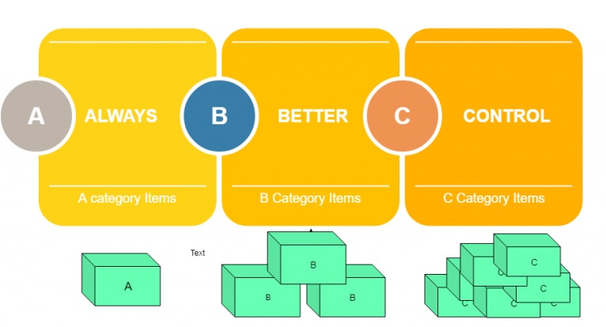
ABC analysis

Slide 8
Design of Inventory
Order Quantity
Economic Order Quantity(EOQ)
Order Timing
Reorder Point
EOQ minimizes the sum of holding and setup costs
Q = 2DCo/Ch
D = annual demand
Co = ordering/setup costs
Ch = cost of holding one unit of inventory

Slide 9
Order Quantity
To determine the quantity of spares to be ordered for each of the item, the following are kept in mind.
Order cost – Cost due to processing of purchase order.
Inventory carrying cost – Interest on capital, storage cost insurance, maintenance cost.
Economic order quantity is the one which considers the cost of ordering and inventory carrying cost.

Slide 10
Spare Parts Development
Development of alternate source of supply of spares form station to build up a competitive atmosphere among the vendors. The objectives are
To optimize the spares cost.
Reduction in lead time.
Quality.

Slide 11
Identification Process
1) High value critical spares of imported origins.
2) Spares whose manufacturing has been discontinued or spares for which poor response from the manufacturers.
3) Spares of Indigenous proprietary origin.

Slide 12
Inventory Control – Central Pool
Objective is to keep high cost, high lead time, spares of interchangeable type with similar stations at one centrally located place.
When need arises any member station can draw from central pool and replenish immediately.

Slide 13
Spare Parts and Procurement action depends upon
Identification of spares of common in nature for the equipments and allocation of material Codification number accordingly.
Consumption History
Fast moving spares
Slow moving spares
Procurement practices
Lead time
Price discounts and bulk purchases.

Slide 14
Purchasing Objectives
Purchasing’s responsibility is to buy materials of the
right quality, in the right quantity, at the right time, at the right price, from the right source, with delivery at the right place.
Furthermore, this objective must be achieved with a minimum investment in inventories.
Achieving this objective of security with a minimum investment demands a fine balancing of various factors:
risk of shutdown, the cost inherent in forward buying, and the economies of quantity purchases.
Weighing these factors calls for experience and a high
order of professional judgment.

Slide 15
Purchasing
Procurement cycle
Review selection
Determine needed quantities
Reconcile needs & funds
Choose procurement method
Select suppliers
Specify contract terms
Monitor order status
Receipt & inspection

Slide 16
In Purchasing
• Purchasing Strategy & Forecasting
• Purchasing Procedures and Techniques
• Supplier Selection & Evaluation
• International Purchasing

Slide 17
Purchasing Strategy & Forecasting
How to make a make-or-buy decision.
How many suppliers do you need?
Which suppliers should be selected?

Slide 18
Purchasing Strategy & Forecasting
How do we forecast the quantity to be purchased?
What kind of forecasting methods should be used?
Time of forecasting

Slide 19
Purchasing Procedures
What are the basic steps of purchasing
Capital Purchases
Requisition
Preparation of Purchase Order
Placing Order
Receiving
Purchasing documentation and forms.
Requisition
Purchase Order
Invoice

Slide 20
Purchasing can be done
Open tender
Restricted or limited tender
– From limited suppliers (about 10)
Negotiated procurement
– Buyer approaches selected potential Suppliers & bargain directly, Used in long time supply contracts
Direct procurement
– Purchased from single supplier, at his quoted price, Prices may be high
Rate contract
– Firms are asked to supply stores at specified Rates during the period covered by the Contract
Spot purchase
– It is done by a committee, which includes an officer from stores, accounts &purchasing departments

Slide 21
Purchasing Procedures and Technique
Some recent trends in procurement:
Electronic Ordering
Stockless Purchasing
Standardization
Just in Time Purchasing

Slide 22
Supplier Selection & Evaluation
How do we find the suppliers and types
– Brokers, Wholesalers, Producers ,etc
Supplier selection standards
Price, Quality, Service, Reliability, Evaluate Performance
Advantages of buying direct and buying from
distribution.

Slide 23
International Purchasing
Have to locate the best sources internationally
Differences in currency, language and culture
Legal issues
Types of agreements
Protection in international purchasing

